Slide 1

Debug Entity Online Cloud Compiler (ONCC) Sprint 7 Presentation
Anchal Singh
Tushar Rakholiya
Sanath Gholap
Brandon Mercado
Ramesh Kyasaram
Harshada Chaudhari

Slide 2
Agenda
Overview
Sprint 6 Recap
Sprint 7 Report
Product Backlog (Sprint 8)
Retrospective
Conclusion
Demo

Slide 3

Overview of Sprint 7
An online cloud compiler web application with five most demanding programming languages such as C/C++, Java, Python and C#.
In this sprint, we resolved bugs for connectivity between C language module having in our application.
The compiler has facilitated with C and C++ language module in the drop-down menu.
Our save feature is available for the authorized users to save their code whenever required for further use.
A bug occurred after embedding C module in flask that disrupted the page layout of the application.

Slide 4
Recap of Sprint 6
Issue Type | ID | Summary | Priority | Status | Story Points
Story | ONCC-36 | As a Guest User, I want to have an option to select C programming language so that I can compile my code written in C language | Highest | In Progress | 22
Task | ONCC-21 | Migration of mongoDB users table into dynamoDB Part-2 | Highest | Done | 8
Task | ONCC-20 | Onboarded whole team on AWS platform | Highest | Done | 8
Task | ONCC-24 | Get the reference of the C compiler using python pre-processing module | Highest | Done | 7
Story | ONCC-26 | As a guest user I want to access a web application on cloud server so that I can compile code in any programming language. | Highest | Done | 4
Task | ONCC-25 | Make a module to take pre-defined input from user for C module | Medium | Done | 7
Task | ONCC-48 | Merge C language compiler module with Flask web application | Medium | In Progress | 5
Task | ONCC-23 | Installation of C compiler module on system | Medium | Done | 5
Task | ONCC-31 | Update User Manual for sprint 6 | Medium | Done | 2
Task | ONCC-29 | Make sprint 6 presentation slides | Medium | Done | 2
Bug | ONCC-49 | Connectivity between the C language module and web application | Medium | In Progress | N/A
Task | ONCC-35 | Update wiki page for sprint 6 | Low | Done | 3
Task | ONCC-30 | Update Technical paper for sprint 6 | Low | Done | 2
Task | ONCC-28 | Update website design and make it more user friendly | Low | In Progress | 3

Slide 5
Sprint 7 Report
Issue Type | ID | Summary | Priority | Status | Story Points
Story | ONCC-36 | As a Guest User, I want to have an option to select C programming language so that I can compile my code written in C language | Highest | Done | 22
Task | ONCC-43 | Embedding compiler into the web Application | Highest | Done | 4
Story | ONCC-51 | As a Guest User, I want to have an option to select C++ programming language so that I can compile my code written in C++ language | Highest | Done | 22
Story | ONCC-37 | As an Existing User, I want the ability to Save my code so that I can retrieve my saved code whenever required | High | Done | 6
Task | ONCC-38 | Create a table for saving code | High | Done | 2
Task | ONCC-53 | Get the reference of the C++ compiler using python pre-processing module | Medium | Done | 7
Task | ONCC-63 | Make a module to take pre-defined input from user for C++ module | Medium | Done | 7
Task | ONCC-54 | Merge C++ language compiler module with Flask web application | Medium | Done | 5
Task | ONCC-52 | Installation of C++ compiler module on system | Medium | Done | 5
Task | ONCC-48 | Merge C language compiler module with Flask web application | Medium | Done | 5
Task | ONCC-46 | Update User Manual | Medium | Done | 3
Bug | ONCC-61 | Layout of the HTML page is disrupted after embedding compiler module in flask web application | Medium | In Progress | 2
Task | ONCC-55 | Update Wiki page on GitHub | Medium | Done | 2
Task | ONCC-44 | Make presentation slides for sprint7 | Medium | Done | 2
Task | ONCC-40 | Fetch saved code from database | Medium | Done | 2
Task | ONCC-45 | Update technical Paper | Medium | Done | 1
Task | ONCC-28 | Update website design and make it more user friendly | Low | Done | 3
Task | ONCC-39 | Update front-end for save feature | Low | Done | 2

Slide 6
Committed and Completed Artifacts
ID | User Story | Acceptance Criteria | Story Priority | Story Points | Task ID | Summary | Task Priority
ONCC-36 | As a Guest User, I want to have an option to select C programming language so that I can compile my code written in C language | Given that the Guest User is on the Home Page, when the user select the option for C programming language from drop-down menu, then the user will be able to write and compile code in C language. | Highest | 22 | ONCC-23 | Installation of C compiler module on system | Medium
 |  |  |  |  | ONCC-24 | Get the reference of the C compiler using python pre-processing module | Highest
 |  |  |  |  | ONCC-25 | Make a module to take pre-defined input from user for C module | Medium
 |  |  |  |  | ONCC-48 | Merge C language compiler module with Flask web application | Medium
ONCC-51 | As a Guest User, I want to have an option to select C++ programming language so that I can compile my code written in C++ language | Given that the Guest User is on the Home Page, when the user select the option for C++ programming language from drop-down menu, then the user will be able to write and compile code in C++ language. | Highest | 22 | ONCC-52 | Installation of C++ compiler module on system | Medium
 |  |  |  |  | ONCC-63 | Make a module to take pre-defined input from user for C++ module | Medium
 |  |  |  |  | ONCC-53 | Get the reference of the C++ compiler using python pre-processing module | Medium
 |  |  |  |  | ONCC-54 | Merge C++ language compiler module with Flask web application | Medium
ONCC-37 | As an Existing User, I want the ability to Save my code so that I can retrieve my saved code whenever required | Given that the Existing User is on the Home Page, the user will be able to save code after clicking on “Save” button. | High | 6 | ONCC-40 | Fetch saved code from database | Medium
 |  |  |  |  | ONCC-38 | Create a table for saving code | High
 |  |  |  |  | ONCC-39 | Update front-end for save feature | Low

Slide 7
Test Cases
Test Cases for | Story ID | Steps | Test Cases | Test Data | Expected Results | Actual Results | Status
Compiler | ONCC 36 | 1 | Writing and compiling the code in C language. | Enters the code in C language and click on Run button | Code should be compiled successfully and get the desired output or errors | Code should be compiled successfully and get the desired output or errors | PASS
 |  |  |  | Enters the code in C language and click on Run button | Code is not successfully compiled and shows error | Code Returns Appropriate Error in the error list | PASS
 |  | 2 | Compiling empty code | Click on Run button without writing code | Will show error for empty code in error field | Shows Empty Code message | PASS
 |  | 3 | Running test code in python pre-processing module | Entering C code in pre-processing module | Getting desired output in String variable | Got output in the String variable | PASS
 |  |  |  | Entering C code in pre-processing module | Getting expected error in Error variable if code is wrong | Got desired error in the Error variable | PASS
 |  |  |  | Entering C code in pre-processing module | Entering Predefined Input for the code to compile with input | Accepting input for written code and compiling with the input | PASS
 |  | 4 | Entering Predefined input | Entering input in the input field for the compilation of code with input parameter | Taking input from input field and adding it into the code | Predefined Input was taken from the code | PASS
 |  |  |  | Entering input in the input field for the compilation of code with input parameter | Showing input missing when the field is empty when required | No Output | FAIL
Save | ONCC-37 | 1 | Saving Code in Database | Code Written in the Code Area and clicking the save button | Code must be saved in the database and should display the title in the saved area | Code is getting stored in the database and it is displayed in the saved area | PASS
 |  | 2 | Saving Code in Database | Empty code is stored | It should pop up the message that code is empty | When clicked on the save with empty code it shows that code is empty | FAIL

Slide 8
Test Cases Continued
Test Cases for | Story ID | Steps | Test Cases | Test Data | Expected Results | Actual Results | Status
Compiler | ONCC-51 | 1 | Writing and compiling the code in C++ language. | Enters the code in C++ language and click on Run button | Code should be compiled successfully and get the desired output or errors | Code should be compiled successfully and get the desired output or errors | PASS
 |  |  |  | Enters the code in C++ language and click on Run button | Code is not successfully compiled and shows error | Code Returns Appropriate Error in the error list | PASS
 |  | 2 | Compiling empty code | Click on Run button without writing code | Will show error for empty code in error field | Shows Empty Code message | PASS
 |  | 3 | Running test code in python pre-processing module | Entering C++ code in pre-processing module | Getting desired output in String variable | Got output in the String variable | PASS
 |  |  |  | Entering C++ code in pre-processing module | Getting expected error in Error variable if code is wrong | Got desired error in the Error variable | PASS
 |  |  |  | Entering C++ code in pre-processing module | Entering Predefined Input for the code to compile with input | Accepting input for written code and compiling with the input | PASS
 |  | 4 | Entering Predefined input | Entering input in the input field for the compilation of code with input parameter | Taking input from input field and adding it into the code | Predefined Input was taken from the code | PASS
 |  |  |  | Entering input in the input field for the compilation of code with input parameter | Showing input missing when the field is empty when required | No Output | FAIL

Slide 9
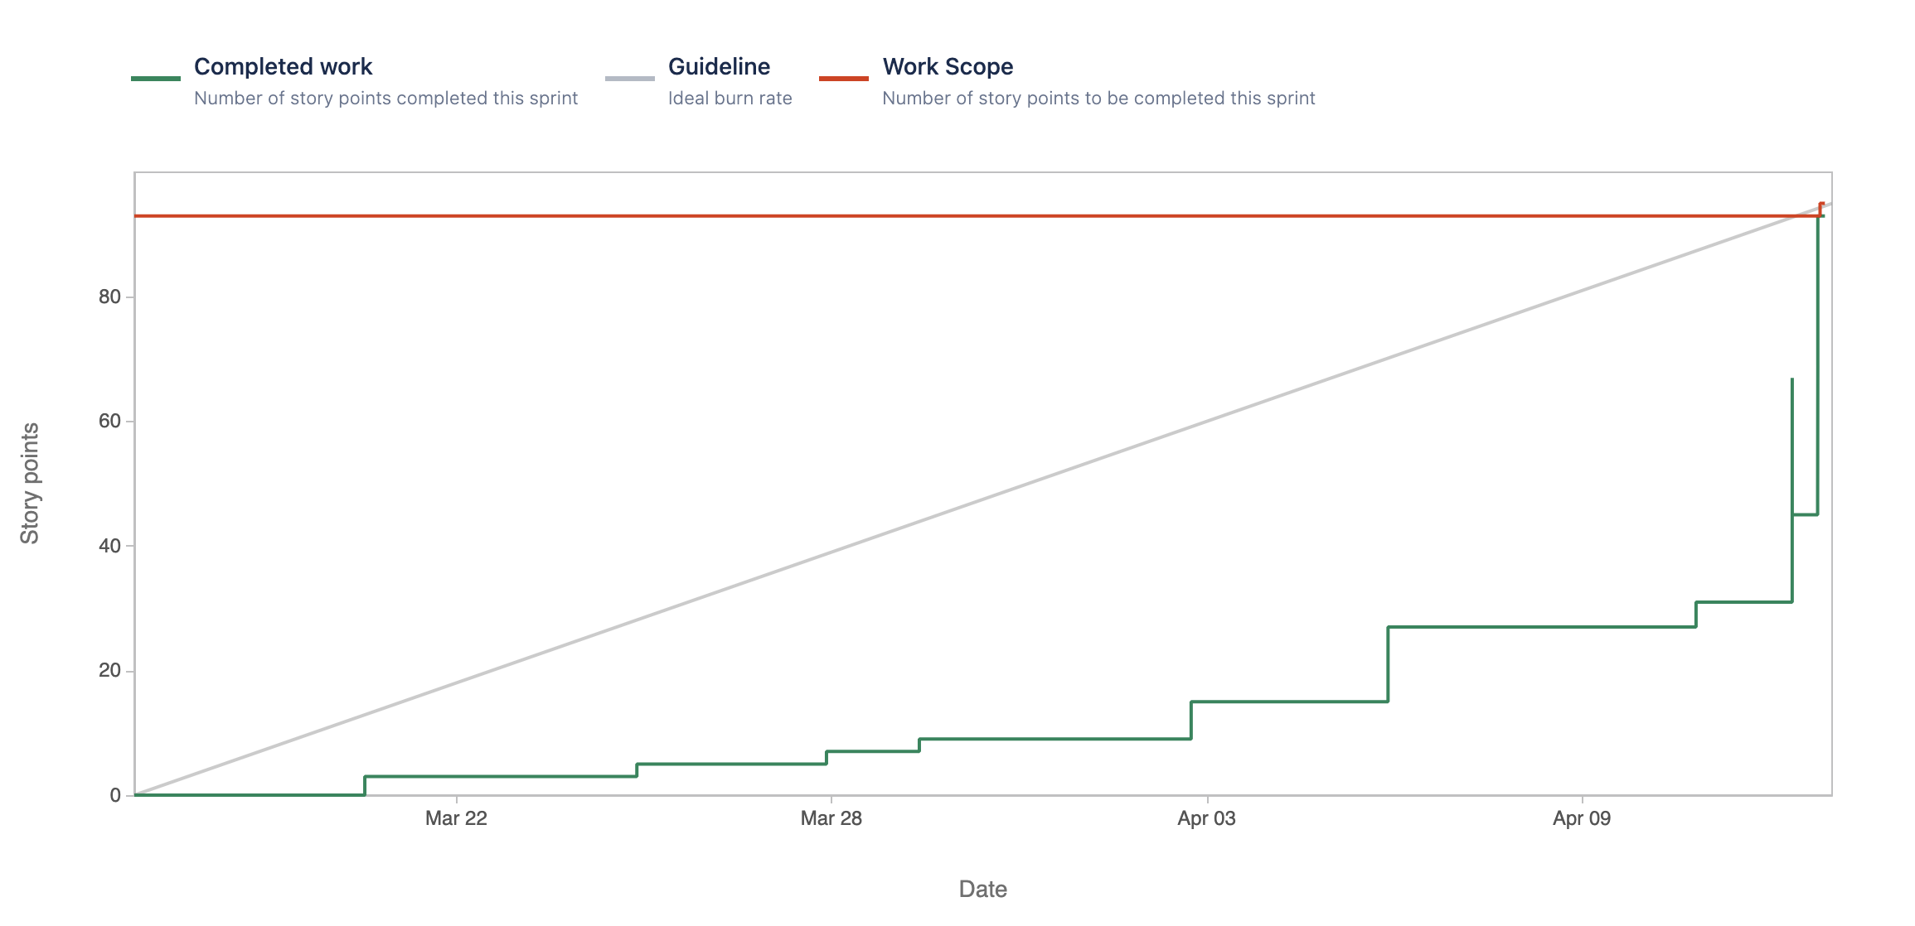
Sprint 7 Burndown Chart

Slide 10
Product Backlog
Issue Type | ID | Summary | Priority | Status | Story Points
Story | ONCC-56 | As a Guest User, I want to have an option to select C# programming language so that I can compile my code written in C# language | Highest | To Do | 22
Task | ONCC-42 | Creating and saving session of logged in user in logDB. | High | To Do | 2
Bug | ONCC-61 | Layout of the HTML page is disrupted after embedding compiler module in flask web application | Medium | In Progress | 2
Task | ONCC-60 | Merging the C language compiler module with Flask web application | Medium | To Do | 5
Task | ONCC-59 | Make a module to take pre-defined input from user for C# language | Medium | To Do | 7
Task | ONCC-58 | Get the reference of the C# compiler using python pre-processing module | Medium | To Do | 7
Task | ONCC-57 | Installation of C# compiler module on system | Medium | To Do | 5
Task | ONCC-50 | Implementing AWS services i.e., Boto3, AWS authy in Compiler | Medium | To Do | 3
Story | ONCC-41 | As a New/Existing User I want to have the New option so that I can write New program | Medium | To Do | 3
Task | ONCC-47 | Add AWS service module in the architecture diagram | Low | To Do | 1
This bug occurred after completion of story ONCC-51 in Sprint 7 and is not related to any stories.

Slide 11
Retrospectives
What went well
Successfully addressed all the feedback, comments and concerns in the documentation.
Minimalized the number of tasks based on the priority and severity.
Brain-stormed to find out the risk of meeting the deadline and acted wisely.
What needs improvement
Needs diving deeper on each task to optimize the planning.
Based on severity level prioritize the fixing the issues or addressing the feedback.
Needs to invest more time on discuss while planning and development.
Next Steps
Schedule a meeting for a detailed discussion on optimizing the planning. Owner : Brandon and Ramesh
Plan how to prioritize the severity level of the issues, feedback or task. Owner : Anchal & Harshada
Come out with the plan how can we improve the discussion on planning and development. Owner : Tushar & Sanath

Slide 12



Conclusion
https://github.com/sg99356n/OnlineCC/wiki

Slide 13
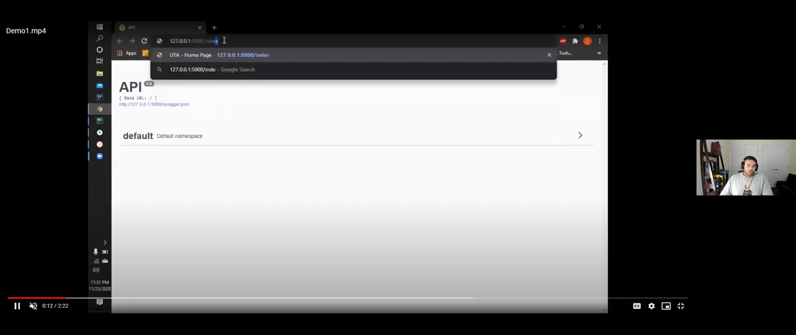
Demo

